Slide 1
OGC ISG Year 2 Sprint Kickoff Presentation: FlightSafety International
Ryan Franz, Staff Software Engineer
June 2, 2021
Notes:
Couple seconds: mention names of organization and primary contacts
Aaron Williams
Spencer Berg

Slide 2
Presentation Tips (delete this slide from your presentation)
The primary audience = the OGC CDB SWG, the Khronos Group, and the Sponsor reps. Also keep in mind your teammates (other Participants).
Identify which Scenario(s) you are working on.
Identify which parts(s) of CDB and/or glTF you will be exploring.
You’re required to address these in your ER-contributions deliverable anyway.

Slide 3
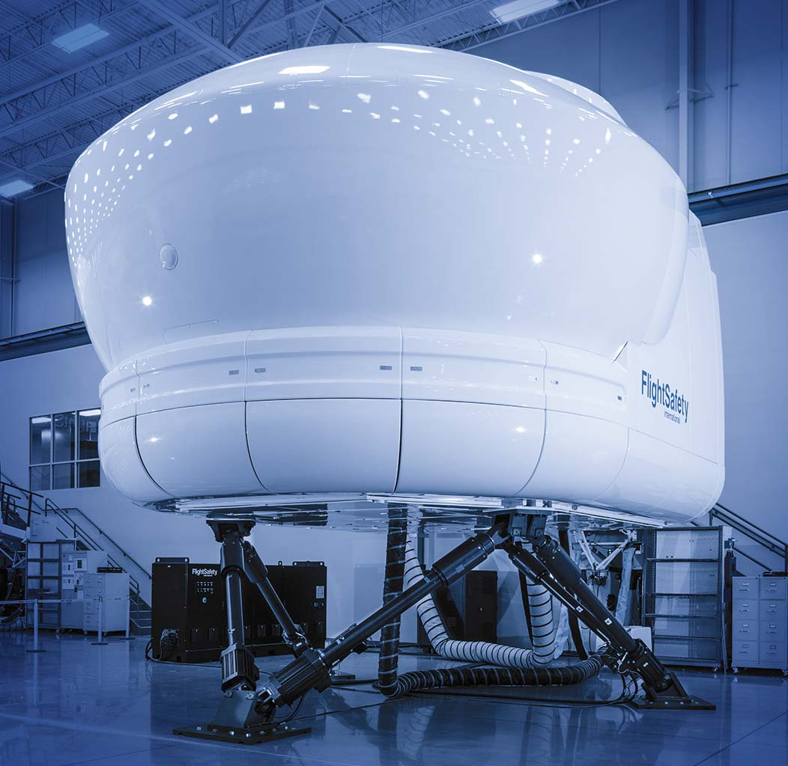
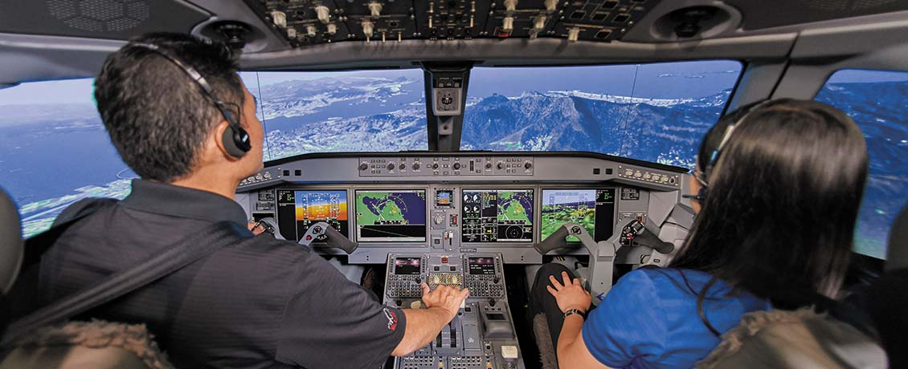
Company Background
FlightSafety Company Background
Professional Aviation Training Company
Supplier of Flight Simulators, Visual Systems and Displays for Commercial, Government and Military Organizations
Early implementer of CDB, funded by SOCOM contract in 2006
Long-time participant in helping guide CDB direction
Industry Board for CDB
OGC CDB SWG Membership
Multi-Spectral Imagery Extension for CDB
Notes:
FlightSafety International is the world’s premier professional aviation training company and supplier of flight simulators, visual systems and displays to commercial, government and military organizations. The company provides training for pilots, technicians and other aviation professionals from 167 countries and independent territories. FlightSafety operates the world’s largest fleet of advanced full-flight simulators at Learning Centers and training locations in the United States, Australia, Brazil, Canada, China, France, Hong Kong, India, Japan, Norway, South Africa and the United Kingdom.
1.4 million hours of training a year, 750,000 hrs in simulators, 1800 professional instructors, 135 current aircraft models
Multi-Spectral Imagery Extension – written to support AFSOC and SOFPREP (Earl Miller)

Slide 4
High-level summary scenario
Scenerio 4 – CDB to glTF Model Conversion
Focus on additional CDB capabilities for military and sensor applications
FlightSafety has experience delivering a variety of sensor systems
Sensor applications are typically the most demanding simulation use case
Areas of Investigation
Preservation of Semantic Attribution
Named zones, damage states, attach points, configurations, motion blur textures, runway and taxiway associations, etc.
Encoding and Storage of Multi-Spectral Reflective Textures
Electromagnetic spectrum that is primarily reflective, Near IR and Short-wave IR
Use cases: Night Vision Goggle (NVG) Simulation and Stimulation, SWIR sensors
Encoding and Storage of Material Data
Underlying material property information
Use cases: Mid-wave and Long-wave (Thermal) Infrared, Radar
Notes:
Other organizations have focused on OpenFlight specific features and their conversion to glTF. This is really good and needed work.

Slide 5
Sprint Goals
Sprint Goals
Identify metadata and semantic attribution that can be encoded into glTF and what needs extensions to glTF
We expect that this will vary based on how OpenFlight is used in CDB
Static Models
Moving Models
2D Tiled Geometry
Identify approaches and/or extensions to use glTF for non-visual use cases

Slide 6
For More Company Information
For further information about FlightSafety International, please visit:
https://www.flightsafety.com/

Slide 7
The end.

